Slide 1

Data Mining Term Project Quality Prediction in Iron Ore
Sai vishal tyagadurgam

Slide 2
Introduction
Iron is extracted from Iron ores which are generally rocks and minerals.
Extracted Iron’s quality is depended on the quality of Iron ore.
The quality of Iron ore is calculated by the amount of silica present in the ore.
Main aim of this project is to predict the quality of these Iron ores at the end of the mining process.

Slide 3
Dataset Description

Slide 4
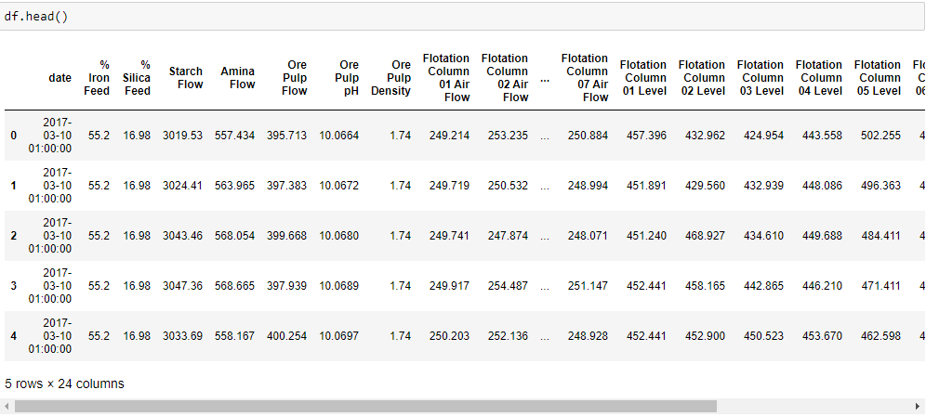
The dataset used in this project is a real time data collected during one of the most important steps of mining process called ‘Flotation Point’.
There are a total of 24 columns in the dataset

Slide 5
The first column of each row in the data set shows about date and time at which the data is recorded.
Most of the rows are sampled for every 20 seconds, some are recorded at an hourly basis.
Second and third columns are the quality measures(% of iron feed, % of silica feed) calculated before iron is fed into the floatation plant.
The data recorded in the columns 4 to 8 are different variables like flow of starch, ammonia, pH level of ore, density which impact the ore quality
Next 14 columns (9 to 22) contain data that is read during this floatation point.
The last 2 columns of each record are % of iron concentrate and % of silica concentrate present in the ore these 2 values are used to calculate the quality of iron ore in lab.
Target of this project is to predict the last column which is the % of silica present in the ore.

Slide 6
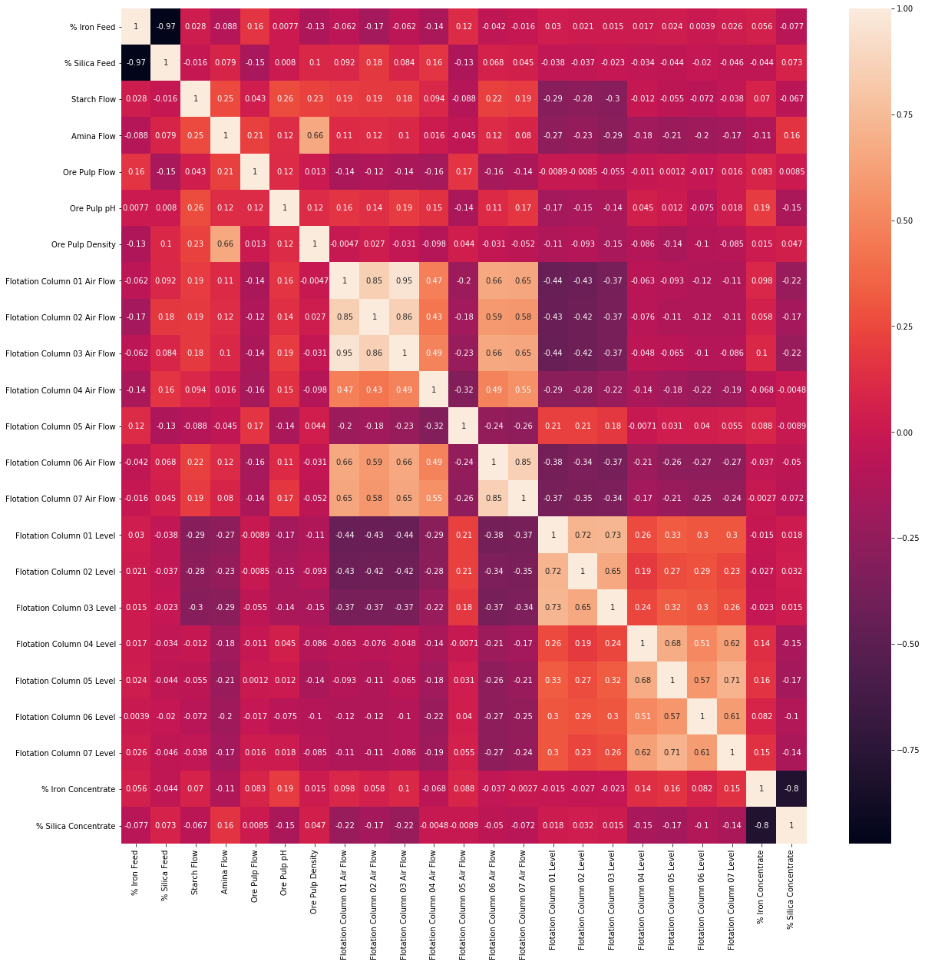

Slide 7
Applied Methods

Slide 8
Regression is a data mining function that predicts a number.
Regression task begins with a data set in which target values are known. For example, a regression model that predicts house values could be developed based on observed data for many houses over a period of time. In this case house value is the target and other attributes are the predictors.
As the aim of this project is to predict a value which is the percentage of silica, I have used regression for this project.
Like the above example, percentage of silica is the target, and the other attributes act as predictors for this model.
I have used different regression methods like Linear Regression, Random Forest, Gradient Boost and Ridge Regression for this project.

Slide 9
Linear Regression

Slide 10
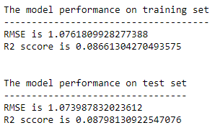
Accuracy of a regression model can be evaluated using metrics like
Root Mean Squared Error (RMSE)
R-Squared Score

Slide 11
Random Forest

Slide 12
Random Forest is a meta estimator that fits a number of decision trees on various sub samples of the dataset and uses averaging to improve the accuracy.
The variables like number of decision trees, depth of those trees can be varied to improve accuracy of the model.
For this model I have performed regression for various depths of trees ranging from 1 to 10.

Slide 13
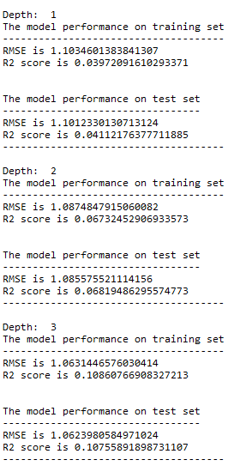
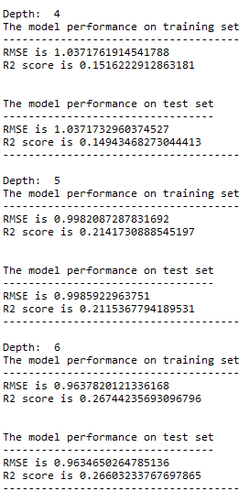
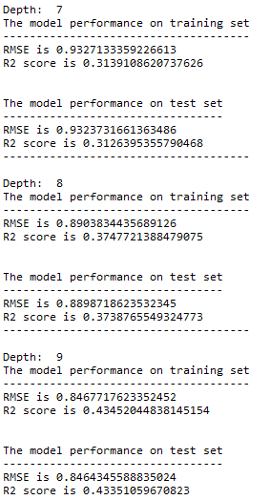

Slide 14
Gradient Boost

Slide 15
Gradient Boosting is used to produce a predictive model from an ensemble of weak predictive models. Gradient Boosting can be used for both regression and classification problems.
For this project I have used regression with regression trees of depth ranging from 1 to 10

Slide 16
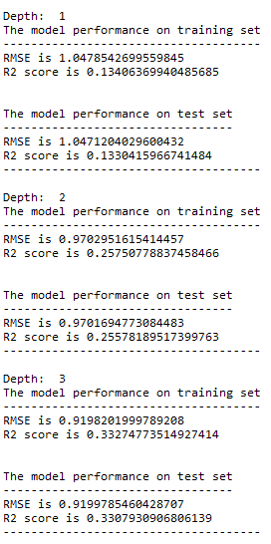
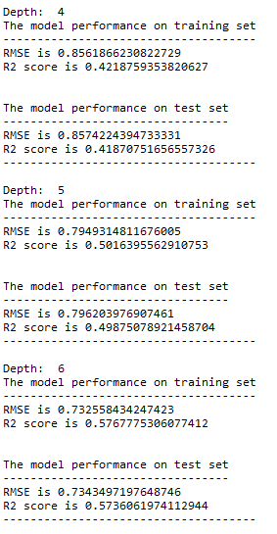
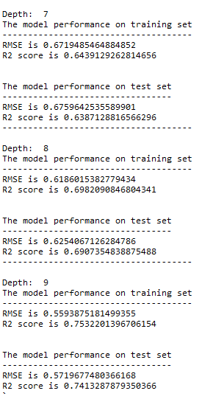

Slide 17
Ridge Regression

Slide 18
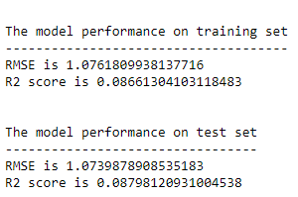
Ridge Regression comes under the family of Linear Regression. The main difference of Ridge Regression from Linear Regression is the loss function.
Ridge Regression uses linear least square function as the loss function and regularization is given by l2-norm.

Slide 19
Results

Slide 20
After applying four different regression methods on the data following results that are observed
Linear Regression : 8.7%
Random Forest Regressor : 43.3% (Depth = 9)
Gradient Boost Regressor : 74.1% (Depth = 9)
Ridge Regression : 8.7%
From the above results we can conclude that linear models are outperformed by Random Forest and Gradient Boost Regressors.
By altering some more parameters like number of estimators, depth of the regression tree the efficiency can be improved.

Slide 21
References

Slide 22
https://www.kaggle.com/edumagalhaes/quality-prediction-in-a-mining-process
https://scikit-learn.org/stable/modules/generated/sklearn.linear_model.LinearRegression.html
https://scikit-learn.org/stable/modules/ensemble.html#forest
https://scikit-learn.org/stable/auto_examples/ensemble/plot_gradient_boosting_regression.html
https://scikit-learn.org/stable/modules/generated/sklearn.linear_model.Ridge.html
https://medium.com/@amanbamrah/how-to-evaluate-the-accuracy-of-regression-results-b38e5512afd3

Slide 23
Thank You

